Slide 1
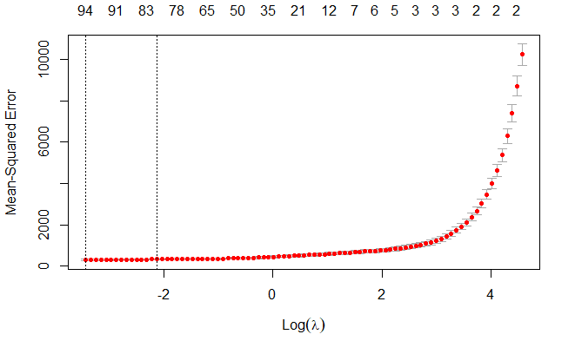
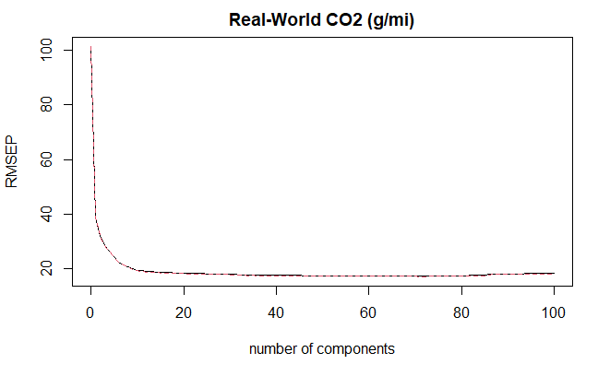

Predicting Automobile Emissions and Regulatory Class with Machine Learning
Classification
Bootstrap 99,999 samples 106 predictors MSEP of 408.9 | Regression
Lasso 73 predictors (1 se) MSEP of 475.44 | Partial Least Squares 56 components MSEP of 404.7
Results/Implications
Why is the outcome interesting. Don’t assume it’s obvious.
Evidence for the results
Potential Next Steps
“Identify the stakeholders in the analysis and its outcomes. Assess any ethical implications of the data (collection methods, sources, structure) or the choices made in the analysis (grouping, selection, etc.) or concerns for implementation.”
“Summarize Findings”
“Offer recommendations for implementation or additional work”
Collin Coil & Thao Huynh
Introduction/Context
What is the context/scope?
What is the question of interest?
Why does it matter/Why should the viewer care?
““executive” summary that succinctly describes the most important findings and recommendations in a manner that entices the viewer/reader to engage more with your poster or report?
Approach
For classification, we tried ________
For regression to predict emissions, we tested bootstrapping, Lasso regression, and partial least squares. We trained these models with 75% of the data and tested with 25%.
Assumptions/Limitations/ or Secondary Results
What constrained the approach
What assumptions need to be checked or were checked
Ethical Considerations
Acknowledgments
Dr. Richard Ressler for teaching Stat 427
Data
The data for this project was the Automotive Trends data set from the EPA.
After cleaning, there were 1958 observations.
This is aggregated data, so we only know average emissions for a manufacturer’s car by regulatory class.
Primary References
Data is accessible at: https://www.epa.gov/automotive-trends/explore-automotive-trends-data#DetailedData

